Slide 1
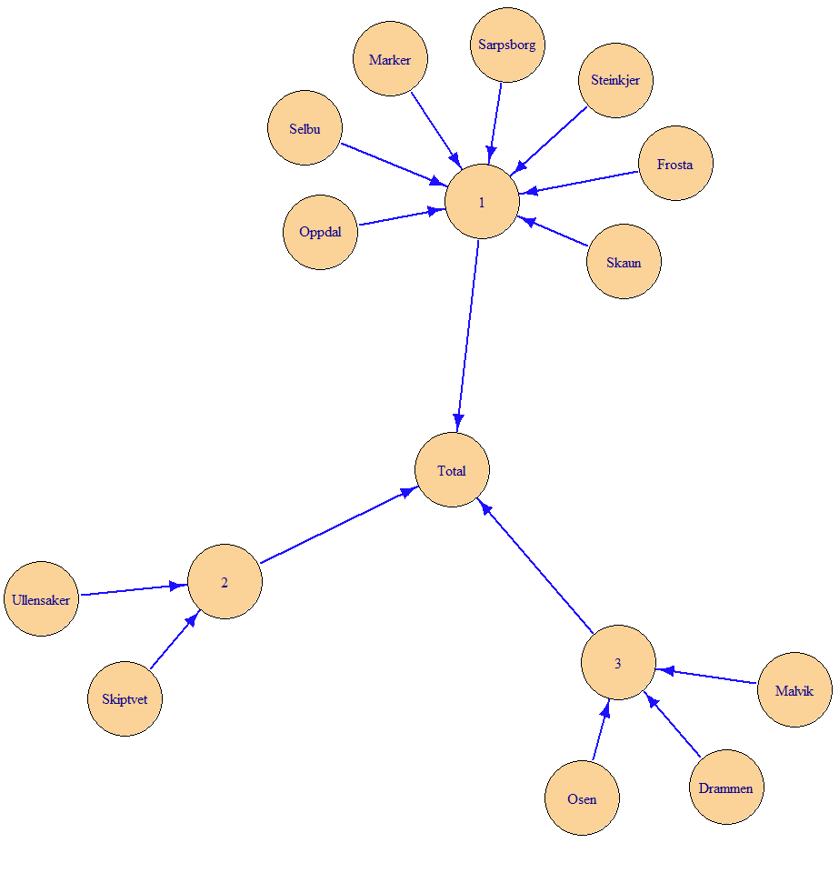
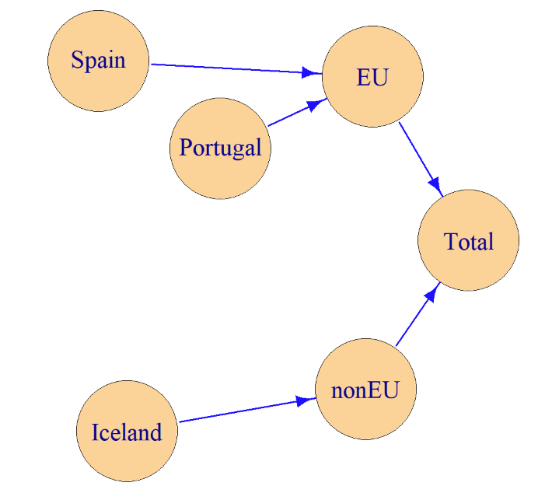
Statistical Disclosure Control
(SDC) day 4, part 1
Recap
hierarchies
removeEmpty
removeCodes
04.03.2024

Slide 2
Recap

Slide 3
Hierarchies
hierarchies

Slide 4
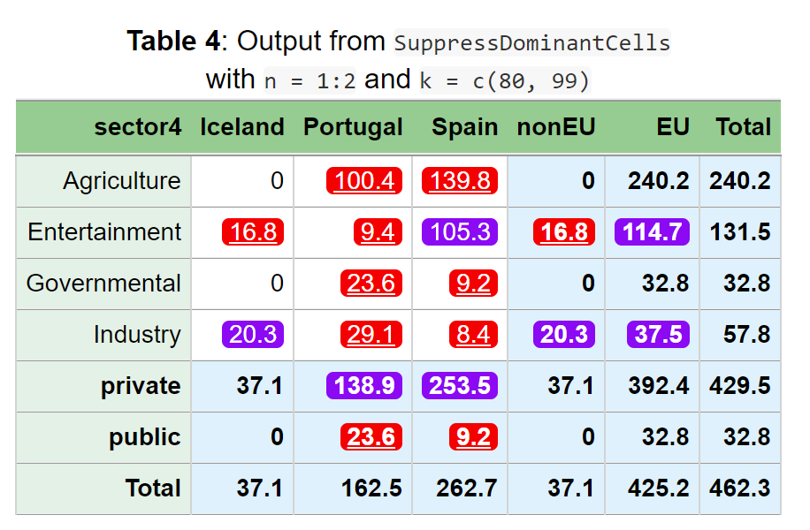
How are variables combined?
4 variables in input dataset
How did 4 input variables become 2 output variables?
sector4 sector2 geo eu company value
1 Agriculture private Portugal EU A 75.9
2 Agriculture private Portugal EU B 24.5
3 Agriculture private Spain EU A 96.6
4 Agriculture private Spain EU B 43.2
:
sector4 geo value primary suppressed
1 Total Total 462.3 - -
2 Total EU 425.2 - -
3 Total nonEU 37.1 - -
4 Total Iceland 37.1 - -
5 Total Portugal 162.5 - -
6 Total Spain 262.7 - -
7 private Total 429.5 - -
8 private EU 392.4 - -
9 private nonEU 37.1 - -
10 private Iceland 37.1 - -
11 private Portugal 138.9 - TRUE
12 private Spain 253.5 - TRUE
:
2 variables in output dataset
Thus, the results could also be summarized in a two-way table as above.

Slide 5
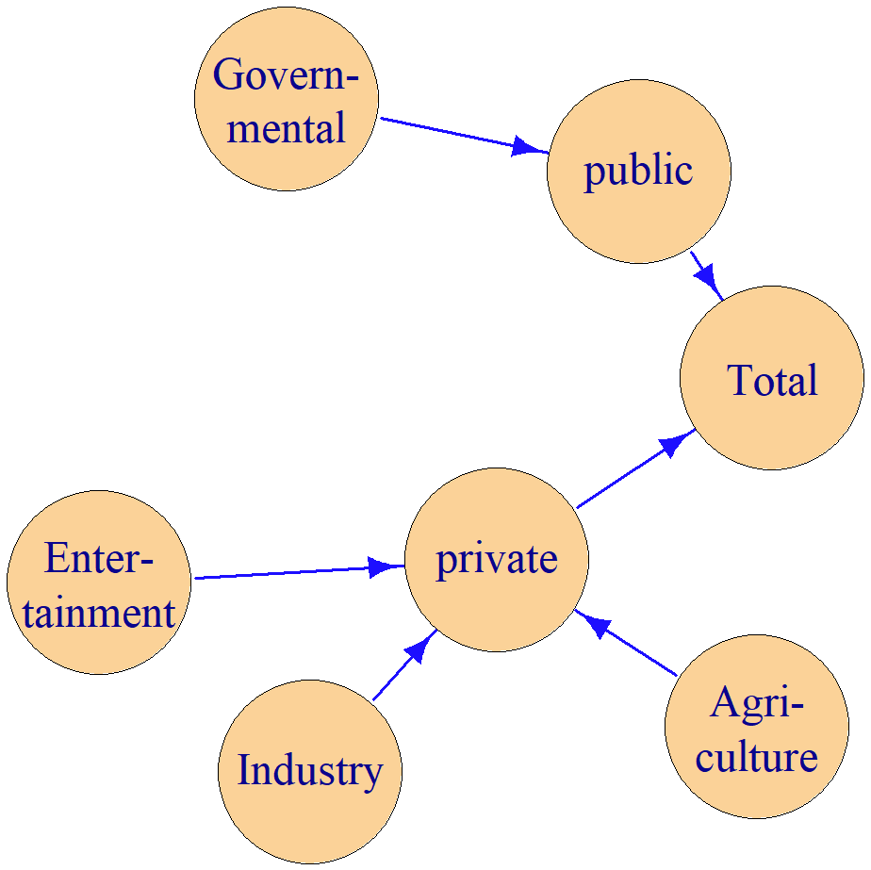
Two hierarchies were automatically discovered
Variable names from the most detailed variable
sector4
geo

Slide 6
• The hierarchy can also be described using the standards in R-package sdcTable or the program tauArgus.
• But the formula specifications on the right side are more general. A tree structure is not needed.
formulas
Total = EU + nonEU
EU = Portugal + Spain
nonEU = Iceland
The formula here is completely different from the formula in the formula interface
sdcTable
levels | codes
@ | Total
@@ | EU
@@@ | Portugal
@@@ | Spain
@@ | nonEU
@@@ | Iceland
tauArgus
EU
@Portugal
@Spain
nonEU
@Iceland
mapsFrom | mapsTo | sign | level
EU | Total | 1 | 2
Portugal | EU | 1 | 1
Spain | EU | 1 | 1
nonEU | Total | 1 | 2
Iceland | nonEU | 1 | 1

Slide 7
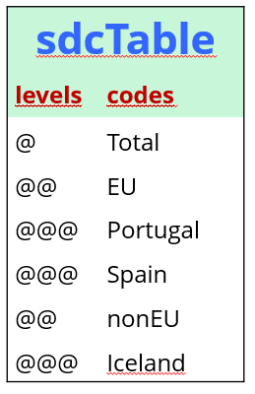
Hierarchies from data
This is code to generate the sdcTable type hierarchy by using the FindDimLists function
> hi1 <- FindDimLists(dataset[c("sector4", "sector2", "geo", "eu")])
> hi1
$sector4
levels codes
1 @ Total
2 @@ private
3 @@@ Agriculture
4 @@@ Entertainment
5 @@@ Industry
6 @@ public
7 @@@ Governmental
$geo
levels codes
1 @ Total
2 @@ EU
3 @@@ Portugal
4 @@@ Spain
5 @@ nonEU
6 @@@ Iceland

Slide 8
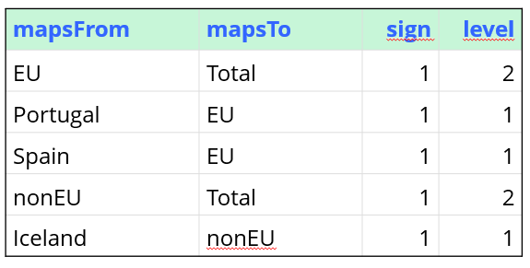
Hierarchies from data
This is code to generate the from-to table by using the FindHierarchies function
> hi3 <- FindHierarchies(dataset[c("sector4", "sector2", "geo", "eu")])
> hi3
$sector4
mapsFrom mapsTo sign level
1 private Total 1 2
2 Agriculture private 1 1
3 Entertainment private 1 1
4 Industry private 1 1
5 public Total 1 2
6 Governmental public 1 1
$geo
mapsFrom mapsTo sign level
1 EU Total 1 2
2 Portugal EU 1 1
3 Spain EU 1 1
4 nonEU Total 1 2
5 Iceland nonEU 1 1

Slide 9
Hierarchies can be input
SuppressDominantCells(data=dataset,
numVar = "value",
hierarchies = hi1,
n = 1:2, k = c(80, 99))
All hierarchy types give the same answer
Same answer as dimVar
SuppressDominantCells(data=dataset,
numVar = "value",
hierarchies = hi3,
n = 1:2, k = c(80, 99))
SuppressDominantCells(data=dataset,
numVar = "value",
dimVar= c("sector4", "sector2", "geo", "eu"),
n = 1:2, k = c(80, 99))
Automation with dimVar
Hierarchies are found from data with FindHierarchies
Then these hierarchies are used as input

Slide 10
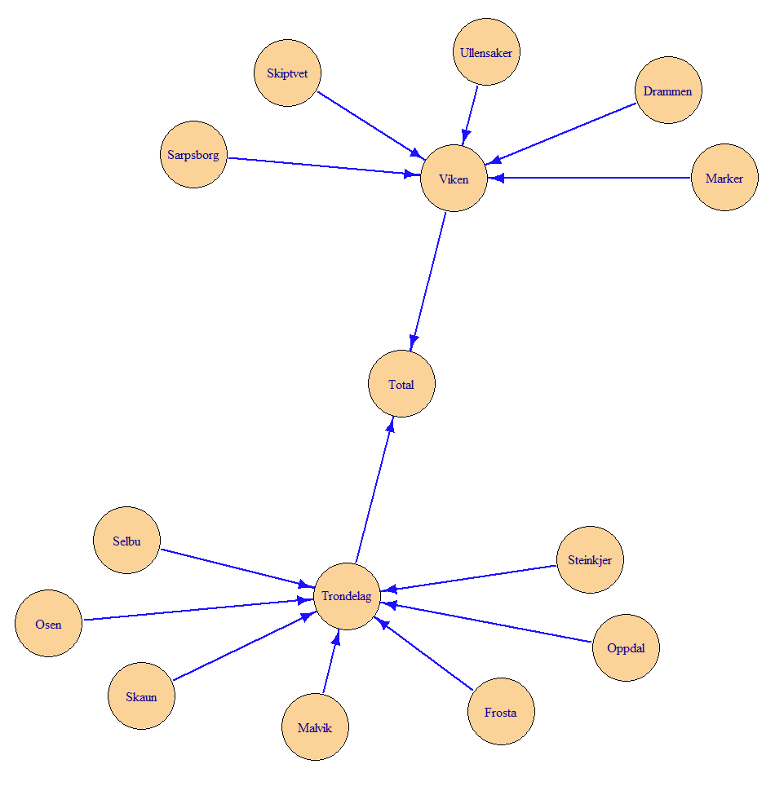
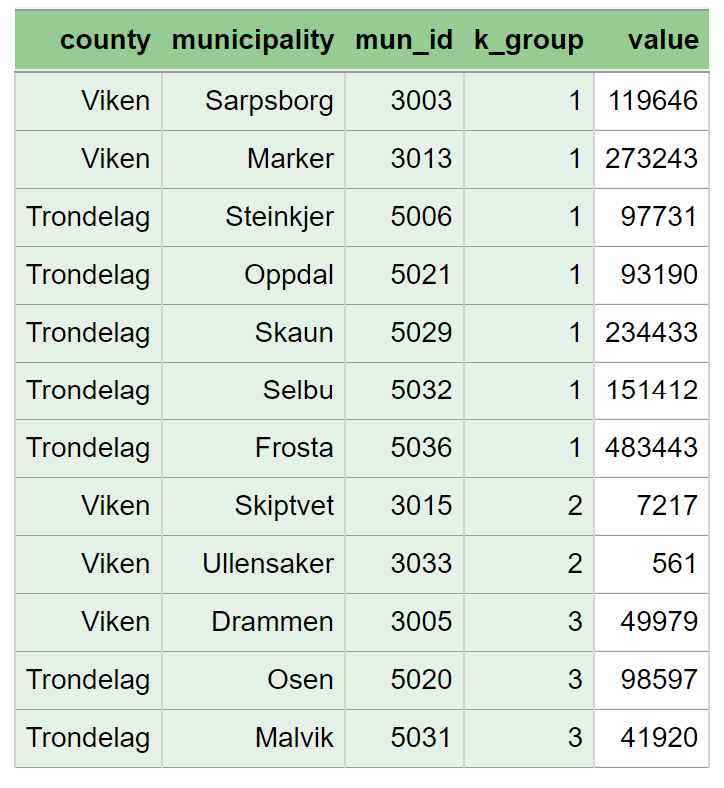
Tree structure
= nested hierarchy
Tree structure when k-group is not included

Slide 11
Tree structure
= nested hierarchy
Tree structure when county is not included

Slide 12
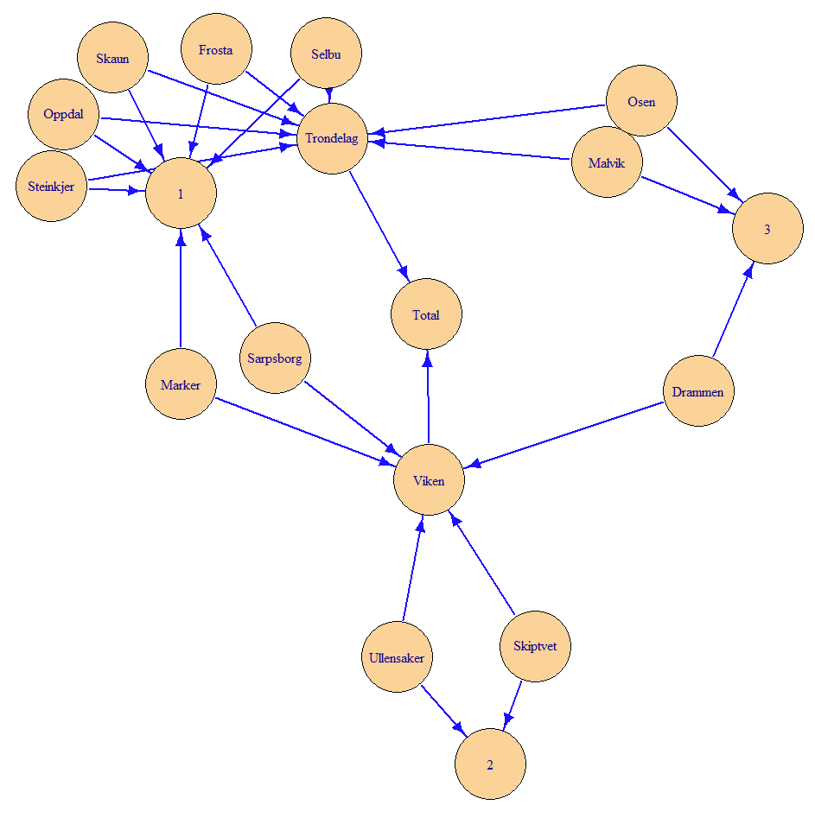
Non-tree structure
= non-nested hierarchy
Non-tree structure when both county and k-group are included

Slide 13
NOTE
Some of the functions are in the SSBtools package
This is new, not recap
Since GaussSuppression depends on the SSBtools package, you already have this package installed.
However, to use the special functions, you need to execute library(SSBtools).
  This applies to functions such as FindDimLists and FindHierarchies.

Slide 14
A difference between the hierarchy and formula interface
removeEmpty

Slide 15
The removeEmpty parameter
Determines whether combinations that have no contribution from input should be included in the output
Default:
  TRUE in the formula interface
  FALSE in the hierarchy interface and for dimVar
But always possible to specify it manually

Slide 16
How to consider open data?
removeCodes

Slide 17
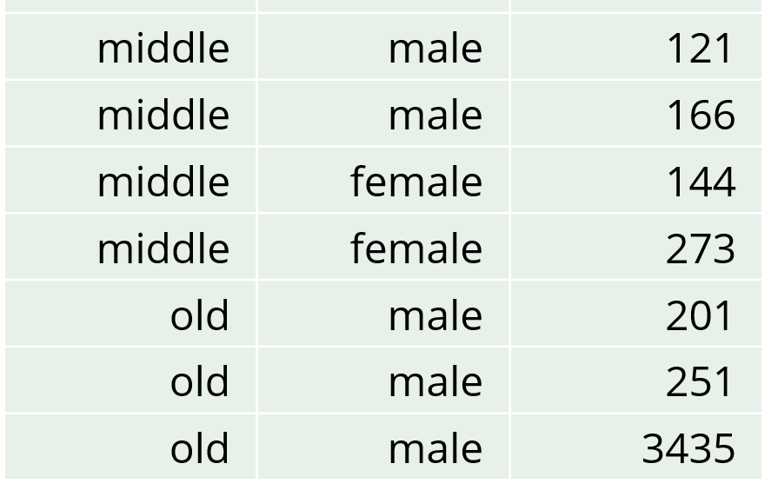
Estimate a value with high accuracy in a magnitude table
age | gender | income | freq
young | female | 328 | 3
young | male | 105 | 1
middle | female | 417 | 2
middle | male | 395 | 3
old | female | 0 | 0
old | male | 3887 | 3
 | young | middle | old | Total
female | 328 | 417 | 0 | 745
male | 105 | 395 | 3887 | 4387
Total | 433 | 812 | 3887 | 5132
This value can be used to estimate …
This value can be used to estimate …
Suppose one person's income is openly available
  The old-male value, 201
Everybody can subtract this value
  The relevant cell total is therefore 3686
  The relevant number of contributors is therefore 2
Primary suppression should be based on these relevant numbers

Slide 18
How to consider open data?
Solution in practice:
SuppressFewContributors
  Use the parameter removeCodes
SuppressDominantCells
  Use the parameter removeCodes

Slide 19
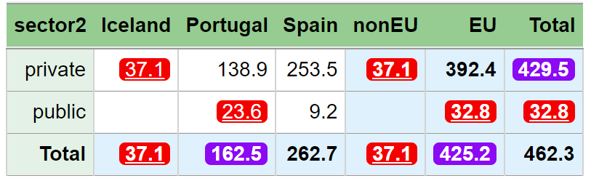
> SuppressFewContributors(data = dataset,
numVar = "value",
formula = ~sector2 * (geo + eu),
maxN = 1,
contributorVar = "company",
removeCodes = c("C", "D"))
sector2 geo freq value nRule nAll primary suppressed
1 Total Total 20 462.3 2 4 - -
2 private Total 16 429.5 2 4 - TRUE
3 public Total 4 32.8 1 3 TRUE TRUE
4 Total Iceland 4 37.1 1 3 TRUE TRUE
5 Total Portugal 8 162.5 2 3 - TRUE
6 Total Spain 8 262.7 2 4 - -
7 Total EU 16 425.2 2 4 - TRUE
8 Total nonEU 4 37.1 1 3 TRUE TRUE
9 private Iceland 4 37.1 1 3 TRUE TRUE
10 private Portugal 6 138.9 2 3 - -
11 private Spain 6 253.5 2 3 - -
12 public Portugal 2 23.6 1 2 TRUE TRUE
13 public Spain 2 9.2 0 2 - -
14 private EU 12 392.4 2 4 - -
15 private nonEU 4 37.1 1 3 TRUE TRUE
16 public EU 4 32.8 1 3 TRUE TRUE
C and D being openly available are handled by the removeCodes parameter
nAll = the number of contributors
nRule = the number of relevant contributors for the suppression rule

Slide 20
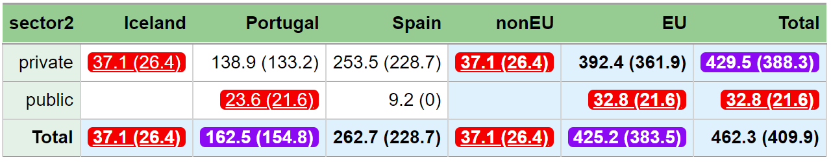
> SuppressDominantCells(data=dataset,
numVar = "value",
formula = ~sector2*(geo + eu),
n = 1, k = 99,
contributorVar = "company",
removeCodes = c("C", "D"))
sector2 geo freq value primary suppressed
1 Total Total 20 462.3 - -
2 private Total 16 429.5 - TRUE
3 public Total 4 32.8 TRUE TRUE
4 Total Iceland 4 37.1 TRUE TRUE
5 Total Portugal 8 162.5 - TRUE
6 Total Spain 8 262.7 - -
7 Total EU 16 425.2 - TRUE
8 Total nonEU 4 37.1 TRUE TRUE
9 private Iceland 4 37.1 TRUE TRUE
10 private Portugal 6 138.9 - -
11 private Spain 6 253.5 - -
12 public Portugal 2 23.6 TRUE TRUE
13 public Spain 2 9.2 - -
14 private EU 12 392.4 - -
15 private nonEU 4 37.1 TRUE TRUE
16 public EU 4 32.8 TRUE TRUE
Here is suppression pattern when considering C and D as open
With the relevant cell values in parentheses

Slide 21
Exercises
exercises/hierarchies.md
Direct link:
  https://github.com/statisticsnorway/kurs-metode-sdc-2024/blob/main/exercises/hierarchies.md

